Slide 1

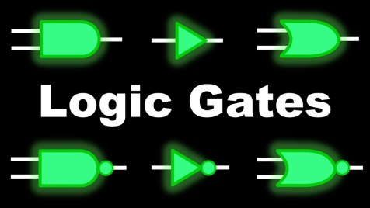
Logic Gates
Presented by : SK Sahil
NOT Gate
EduTech

Slide 2


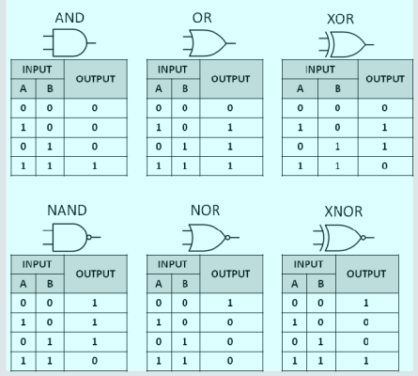
Topics Covered
Understand all the Logic Gates Concept
Draw Circuit Diagrams & Truth Tables
Revision All the Logic Gates
Practice PYQ’s
Laws of Boolean Algebra
De-Morgan’s Theorem
→Syllabus Roadmap
→Bonus Tips (How to solve this kind of problem?)

Slide 3
Terminologies
Row
Column
Circuit diagram
Truth Table
Logic Gates
Universal Gates
Binary Number (0,1)
Input, Output, Series & Parallel Connection
Agulo jantei hobe ai topic a command ante gele

Slide 4




Basic Logic Gates
AND Gate
OR Gate
NOT Gate
A , B are inputs & Y is the output

Slide 5

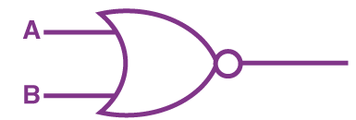
Universal Gates
NAND Gate
NOR Gate

Slide 6
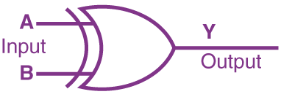
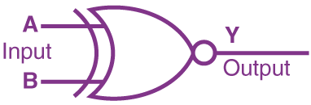
Special Gates
XOR Gate
X-NOR Gate

Slide 7
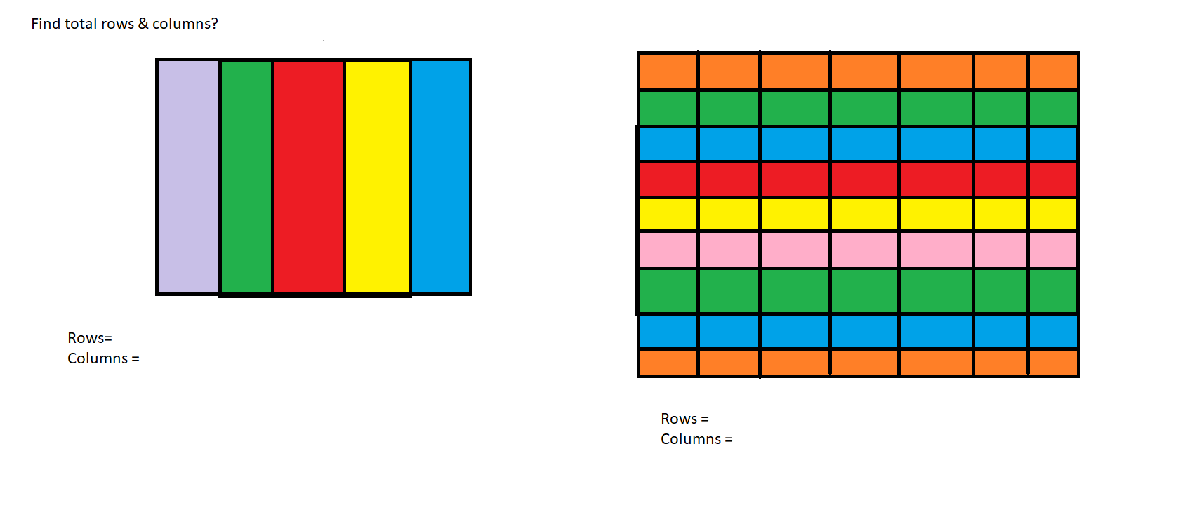

Slide 8
How to make truth table?
Input
A B C D
0 | 0 | 0 | 0
0 | 0 | 0 | 1
0 | 0 | 1 | 0
0 | 0 | 1 | 1
0 | 1 | 0 | 0
0 | 1 | 0 | 1
0 | 1 | 1 | 0
0 | 1 | 1 | 1
1 | 0 | 0 | 0
1 | 0 | 0 | 1
1 | 0 | 1 | 0
1 | 0 | 1 | 1
1 | 1 | 0 | 0
1 | 1 | 0 | 1
1 | 1 | 1 | 0
1 | 1 | 1 | 1
Input
A B
Input
A B C
2^{N}
^{N is total input} no.
0 | 0
0 | 1
1 | 0
1 | 1
0 | 0 | 0
0 | 0 | 1
0 | 1 | 0
0 | 1 | 1
1 | 0 | 0
1 | 0 | 1
1 | 1 | 0
1 | 1 | 1
Row=
Column=
0 means OFF
1 means ON

Slide 9
AND Gate
Circuit diagram
A
F = A . B
B
A
F = A . B . C
B
C
A
B
F = A . B . C . D
C
D
Note: Red lines are input lines & Green lines are output lines.

Slide 10
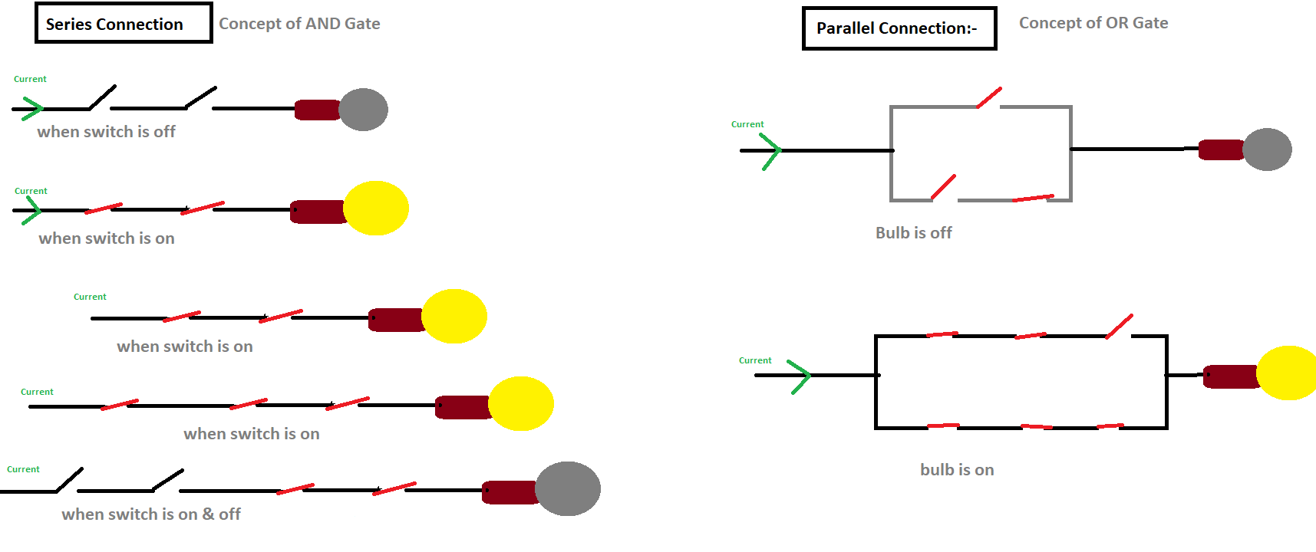
Remember: When all switch are 1 output will be 1, 1 = Switch On, 0= Switch Off

Slide 11
AND Gate
2^{N}
Truth Table
Input Output
A B O= A.B
Circuit Diagram
0 | 0 | 0
0 | 1 | 0
1 | 0 | 0
1 | 1 | 1
Input Output
A B C O=A.B
A
F = A . B
B
0 | 0 | 0 | 0
0 | 0 | 1 | 0
0 | 1 | 0 | 0
0 | 1 | 1 | 0
1 | 0 | 0 | 0
1 | 0 | 1 | 0
1 | 1 | 0 | 0
1 | 1 | 1 | 1
A
F = A . B . C
B
C

Slide 12
AND Gate
Circuit Diagram
It is a basic logic gate.
When two inputs are 1 then the output will be 1.
Always one output.
Minimum inputs will be 2.
Output represents the dot(.) symbol
A
F = A . B
B
Truth Table
Input Output
A B O= A.B
A
F = A . B . C
B
C
0 | 0 | 0
0 | 1 | 0
1 | 0 | 0
1 | 1 | 1

Slide 13
OR Gate
Circuit diagram
A
F = A + B
B
A
F = A + B + C
B
C
A
B
F = A + B + C + D
C
D

Slide 15
OR Gate
2^{N}
Truth Table
Input Output
A B O= A.B
Circuit Diagram
0 | 0 | 0
0 | 1 | 1
1 | 0 | 1
1 | 1 | 1
Input Output
A B C O=A+B
A
F = A + B
B
0 | 0 | 0 | 0
0 | 0 | 1 | 1
0 | 1 | 0 | 1
0 | 1 | 1 | 1
1 | 0 | 0 | 1
1 | 0 | 1 | 1
1 | 1 | 0 | 1
1 | 1 | 1 | 1
A
F = A + B + C
B
C

Slide 16
OR Gate
Truth Table
It is a basic logic gate.
When two inputs are 0 then the output will be 0.
Always one output.
Minimum inputs will be 2.
Output represents the plus(+) symbol
Input Output
A B O= A.B
0 | 0 | 0
0 | 1 | 1
1 | 0 | 1
1 | 1 | 1
Circuit Diagram
A
F = A + B
B
Red lines are input & green line is output.

Slide 17
NOT Gate
Truth Table
Circuit Diagram
Input Output
A O=A’
A
F = A’
0 | 1
1 | 0
0 | 1
1 | 0
0 | 1
1 | 0
0 | 1
1 | 0
It is a basic logic gate. It is also called as Inverter Gate.
It has only one input & one output.
When input is 0 , output will be 1. (vice-versa)
Output represents the bar/complement
( ) symbol. (bar & complement symbol)
Input Output
A O= A’
0 | 1
1 | 0

Slide 18
NAND Gate
Circuit diagram
A
F = (A . B)’
B
A
F = (A . B . C)’
B
C
A
B
F = (A . B . C . D)’
C
D

Slide 19
NAND Gate
2^{N}
Truth Table
Input Output
A B O= (A.B)’
Circuit Diagram
0 | 0 | 1
0 | 1 | 1
1 | 0 | 1
1 | 1 | 0
Input Output
A B C O=(A.B)’
A
F = (A . B)’
B
0 | 0 | 0 | 1
0 | 0 | 1 | 1
0 | 1 | 0 | 1
0 | 1 | 1 | 1
1 | 0 | 0 | 1
1 | 0 | 1 | 1
1 | 1 | 0 | 1
1 | 1 | 1 | 0
A
F = (A . B . C)’
B
C

Slide 20
NAND Gate
Truth Table
It is a universal logic gate.
It consists of AND & Not Gate. ( NAND=Not + AND)
It is totally opposite of AND Gate.
When two inputs are 1 then the output will be 0.
Always one output.
Minimum inputs will be 2.
Output represents the dot(.) symbol & bar symbol.
Input Output
A B O= (A.B)’
0 | 0 | 1
0 | 1 | 1
1 | 0 | 1
1 | 1 | 0
Circuit Diagram
A
F = (A . B)’
B

Slide 21
NOR Gate
Circuit diagram
A
F =( A + B)’
B
A
F = (A + B + C)’
B
C
A
B
F = (A + B + C + D)’
C
D

Slide 22
NOR Gate
2^{N}
Truth Table
Input Output
A B O= (A+B)’
Circuit Diagram
0 | 0 | 1
0 | 1 | 0
1 | 0 | 0
1 | 1 | 0
Input Output
A B C O=(A+B)’
A
F =( A + B)’
0 | 0 | 0 | 1
0 | 0 | 1 | 0
0 | 1 | 0 | 0
0 | 1 | 1 | 0
1 | 0 | 0 | 0
1 | 0 | 1 | 0
1 | 1 | 0 | 0
1 | 1 | 1 | 0
B
A
F = (A + B + C)’
B
C

Slide 23
NOR Gate
Input Output
A B O= (A+B)’
It is a universal logic gate.
It consists of OR & Not Gate. (NOR=Not + OR)
It is totally opposite of OR Gate.
When two inputs are 1 then the output will be 1.
Always one output.
Minimum inputs will be 2.
Output represents the plus(+) symbol & bar symbol.
0 | 0 | 1
0 | 1 | 0
1 | 0 | 0
1 | 1 | 0
A
F =( A + B)’
B

Slide 24
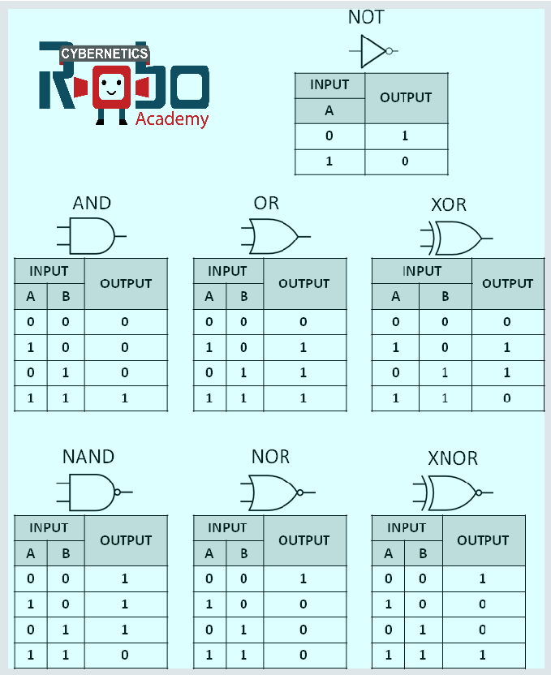
X-OR Gate
It is special logic gate.
When two inputs are same then the output will be 0
Always one output.
Minimum inputs will be 2.
Output represents the ____ symbol
A + B= A.B + A.B

Slide 25
X-NOR Gate
It is special logic gate.
When two inputs are same then the output will be 1.
Always one output.
Minimum inputs will be 2.
Output represents the _______ symbol
A + B= A.B + A.B

Slide 26

Full Revisions
Circuit Diagrams
0 = OFF
1 = ON
AND Gate opposite NAND Gate
OR Gate Opposite NOR Gate
Minimum inputs line should be 2
Always final output line should be 1
NOT Gate= inverter Gate

Slide 27
Full Revisions
Truth Tables
INPUT OUTPUT
AND Gate OR Gate NOT Gate NAND Gate NOR Gate XOR Gate XNOR Gate NOT Gate
A | B | F=A.B | F=A+B | F=A’ | F=(A.B)’ | F=(A+B)’ | F=A + B | F=(A + B)’ | F=B’
0 | 0 | 0 | 0 | 1 | 1 | 1 | 0 | 1 | 1
0 | 1 | 0 | 1 | 1 | 1 | 0 | 1 | 0 | 0
1 | 0 | 0 | 1 | 0 | 1 | 0 | 1 | 0 | 1
1 | 1 | 1 | 1 | 0 | 0 | 0 | 0 | 1 | 0
0 = OFF
1 = ON
AND Gate opposite NAND Gate
OR Gate Opposite NOR Gate
Minimum inputs line should be 2
Always final output line should be 1
NAND = NOT + AND Gate
NOR = NOT + OR Gate
XOR = Exclusive- OR Gate
XNOR= Exclusive- NOR Gate
NOT Gate= inverter Gate
Nije banao same(Try yourself) ,when input is 3

Slide 28
PYQ (Previous Year Ques)
What is the output of the following gates?

Slide 29
PYQ (Previous Year Ques)
What is the output of the following gates?

Slide 30
PYQ (Previous Year Ques)
What is the output of the following gates?

Slide 31
PYQ (Previous Year Ques)
Draw the circuit diagram & truth table of AND Gate.
Draw the circuit diagram & truth table of OR Gate.
Draw the circuit diagram & truth table of NOT Gate.
Draw the circuit diagram & truth table of NAND Gate.
Draw the circuit diagram & truth table of NOR Gate.
Draw the circuit diagram & truth table of XOR Gate.
Draw the circuit diagram & truth table of XNOR Gate.
Mention na kora thakle sob 2 to input line diye banabe, ager slide a sob banano ache
Dekhe note down kore nao
Next class feel korte gele ai topic a command rakhte hobe, so practice koro jevabe bolechi

Slide 32
Important Symbols Name
Parenthesis ( …. )
Curly Braces { …. }
Square Bracket [ …. ]
Complement or BAR ‘

Slide 33
Laws of Boolean Algebra
Identity x + 0 = x x . 1 = x
Complement x + x ‘ = 1 x . x’ = 0
Commutative x + y = y + x x . y = y . X
Distributive x . ( y +z )= x . y + x . z x + (y . z )= (x + y) . (x + z)
Addition Theorem x + x = x
Multiplication Theorem x . 0 = 0
Theorem x + 1 =1 x . 0 = 0
Associative x + ( y + z ) = ( x + y ) + z x . ( y . z )= ( x . y ) . z
De-Morgan’s Theorem ( x + y )’ = x’ . y’ ( x . y )’ = x’ + y’
Absorption Theorem x + xy = x x . ( x + y )= x
Involution Theorem (x’)’ = x

Slide 34
Simplification of Boolean Expressions
Simplify the Boolean expression xy + x’y’ + xy’
Next class a ai problem solve korte gele laws of boolean expression valo vabe memorise kore aso

Slide 35
How to solve this kind of problem in exams?
Truth table draw (2 input, 3 input, 4 input)
All Gates draw (5 times) – with different colour
Revision table make (2 input, 3 input)
Boolean law (think about logic gate)

Slide 36

Thank You for joining this class.
I fear not the man who has practiced ten thousand kicks once, but I fear the man who has practiced one kick ten thousand times.
consistency
Hard Work
Output= C+H+R.D= Success
Right Direction
OR Gate
~Bruce Lee

